Slide 1
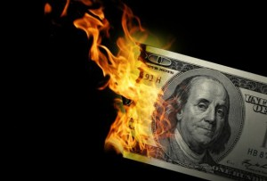
CS1951 L
Blockchains & Cryptocurrencies
Fall 2025
Lecture 8
Gas
Maurice Herlihy
Brown University

Slide 2

Road Map
How gas started (Classic Ethereum)
Why gas changed (Ethereum today)

Slide 3
What is Gas?
Caller pays fee for each transaction step
Makes denial of service attacks expensive

Slide 4
How does gas work?
Caller prepays transaction’s gas
Out of gas?
Rollback, no refund
Leftover gas?
Unused fees refunded

Slide 5
Part I Classical Gas (Ethereum pre-2021)

Slide 6
Gas (Classic Ethereum)
Before 2021, caller picks own gas price!
Miners collect gas payments, so …
Higher price means higher priority
Can prioritize more valuable transactions

Slide 7
Caller offers
fee cap := gas limit X gas price
paid to successful miner

Slide 8
Block Gas Limit
Bitcoin has limit on block size
Ethereum had 15M limit on block gas
Block full when transactions’ gas costs reach limit

Slide 9
This Changes Everything
“London Hard Fork”
Changes gas price model
Why was a change needed?
What was changed?
Consequences?

Slide 10






Reminder
Clients
Miners

Slide 11
Why Fees?
Want transactions!
Want transactions
Want transactions
Want transactions
Want transactions
We have Limited Space in Blocks

Slide 12

High-value vs Low-value txns
Super important
Pretty important
Meh ..
Not enough space for everyone

Slide 13
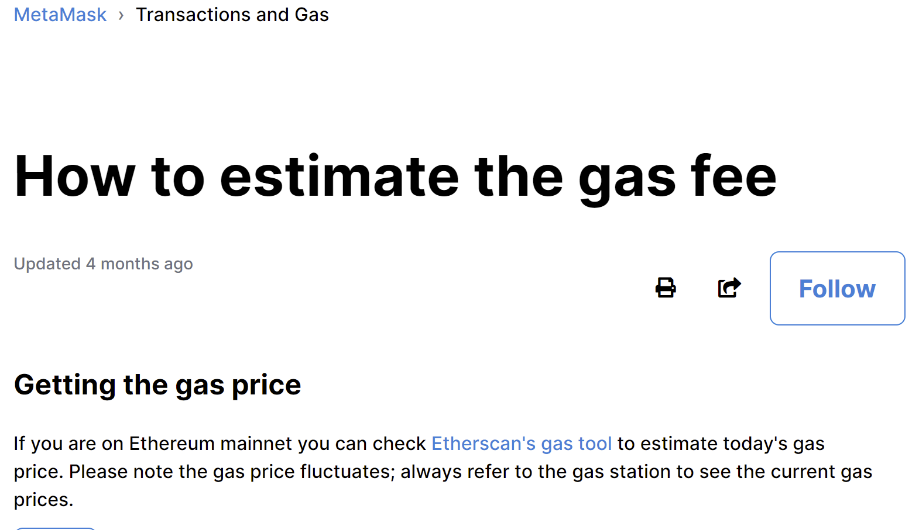
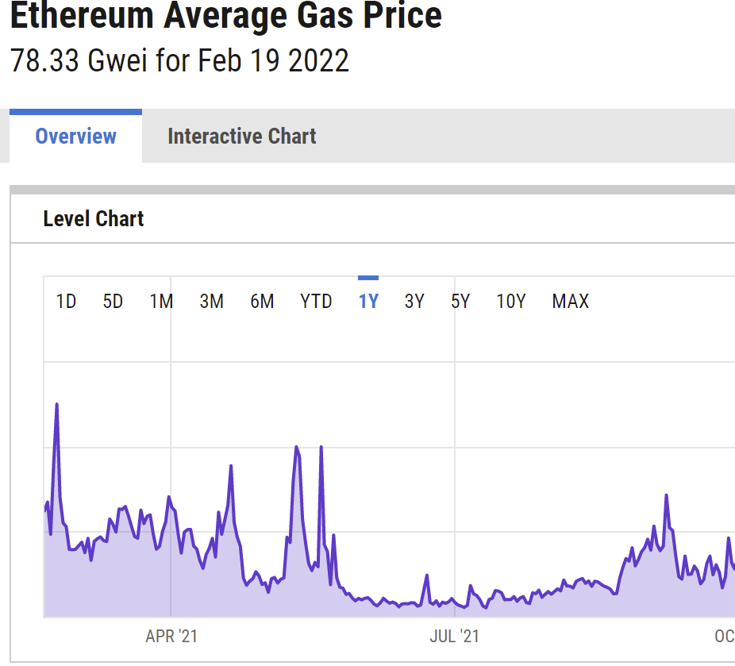
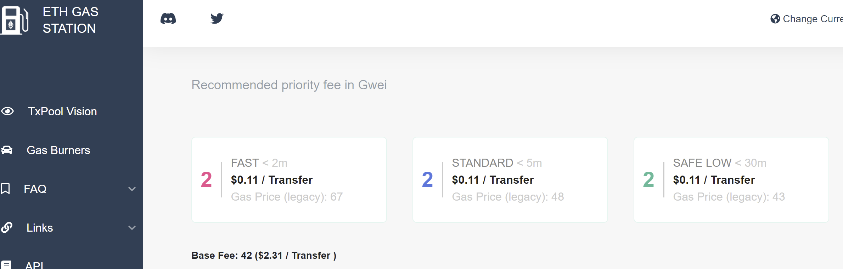
Gas Price Estimation Services?
Normally works fine
Inaccurate when chain is volatile
“Surprise! New NFT just announced”

Slide 14
Blind Auction
$100
$50
$25
Place your bids

Slide 15
Blind Auction
$100
$50
$25
Place your bids

Slide 16
First-Price Auction
$100
$50
$25
In, for $100
In, for $50
Out

Slide 17
Regret
I should have bid less!
In, for $100
In, for $50
Out

Slide 18
Blind Auction
$100
$125
$125
Place your bids

Slide 19
Blind Auction
$100
$125
$125
Place your bids

Slide 20
First-Price Auction
$100
$125
$125
Out
In, for $125
In, for $125

Slide 21
Regret
I should have bid more!
Out
In, for $125
In, for $125

Slide 22


Uniform Price Auction
$100
$50
$25
In
In
out (block full)

Slide 23
Uniform Price Auction
$100
$50
$25
In
In
out (block full)
That’s $50 each

Slide 24

Regret-Free Auctions?
Bid honestly
Included if price ≤ value
Excluded if price ≥ value
Either way, no regrets

Slide 25
What could possibly go wrong?

Slide 26
What could go wrong?
$100
$100
$25
Space for 3 txns,
Clearing price is $25,
my profit is $75.

Slide 27
What could go wrong?
$100
$100
$25
$100
Fake bid!

Slide 28
What could go wrong?
$100
$100
$25
$100
Clearing price now $100,
profit went from $75 to $200.

Slide 29
What else could go wrong?
Double your bid and I will secretly refund you!
Heh-heh
Heh-heh

Slide 30
Part II Fixing Gas (Modern Ethereum)

Slide 31
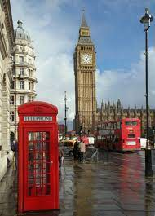

London Hard Fork

Slide 32
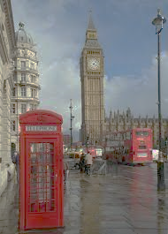

London Hard Fork
Goals
Dampen short-term volatility
Better user experience
Make fees more predictable

Slide 33
London Hard Fork
Non-Goals
Lower fees for users
Lower fees is scalability problem …
Supply vs demand not mechanism design

Slide 34
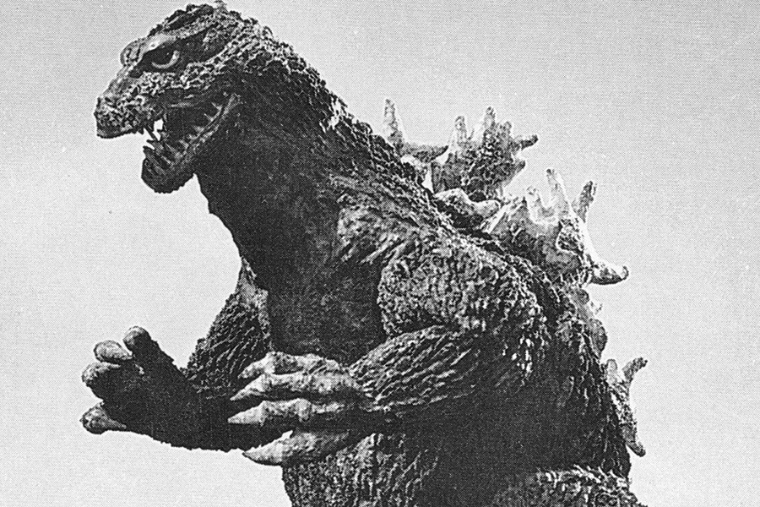
Possible Attacks
Miners create fake transactions
Off-chain black market

Slide 35
Transaction Fees
Base fee
Tip
fixed by chain
burned
fixed by user
paid to miner
(per gas unit)

Slide 36
Flexible Block Size (in Gas)
target
maximum

Slide 37

Base Fee Calculation
$
≤12.5%
$
≤ 12.5%

Slide 38
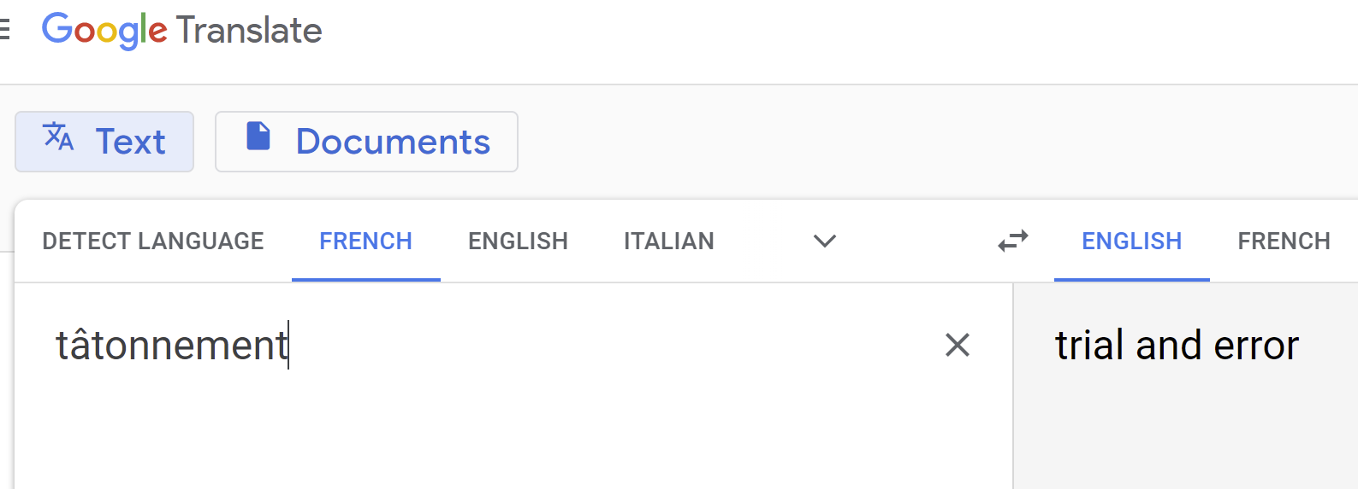
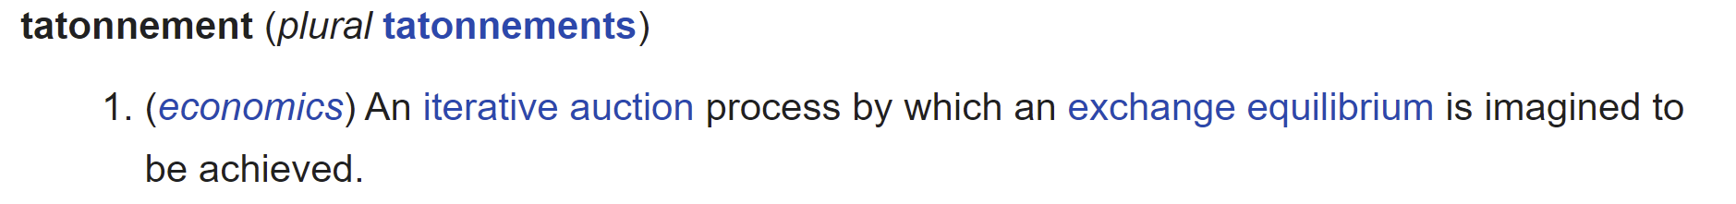
Vocabulary: Tâtonnement

Slide 39
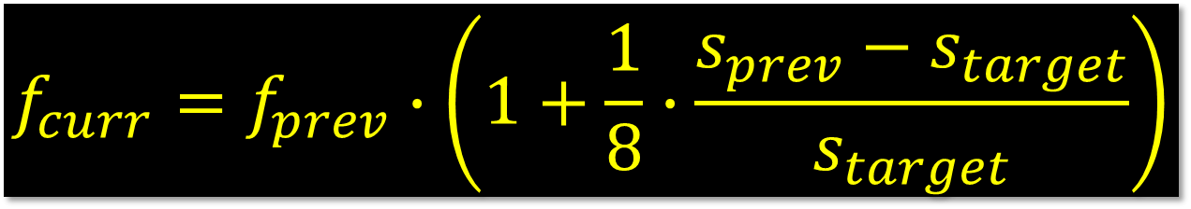
Base Fee Calculation
$$f_{curr}=f_{prev}∙\left(1+\frac{1}{8}∙\frac{s_{prev}{− s}_{target}}{s_{target}}\right)$$

Slide 40
Base Fee Calculation
Target block size (15M gas)
Base fee for previous block
$$f_{curr}=f_{prev}∙\left(1+\frac{1}{8}∙\frac{s_{prev}{− s}_{target}}{s_{target}}\right)$$
Base fee for current block
Size of previous block (in gas)

Slide 41
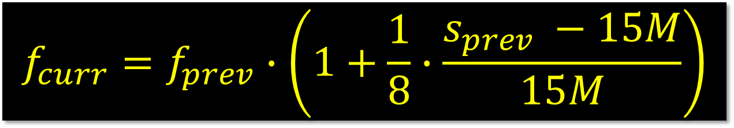
Base Fee Calculation
$$f_{curr}=f_{prev}∙\left(1+\frac{1}{8}∙\frac{s_{prev} −15M}{15M}\right)$$

Slide 42

Previous Block Half Full?
$$f_{curr}=f_{prev}∙\left(1+\frac{1}{8}∙\frac{15M−15M}{15M}\right)$$

Slide 43

Previous Block Half Full?
$$f_{curr}=f_{prev}∙\left(1+\frac{1}{8}∙0\right)$$

Slide 44
Previous Block Half Full?
$$f_{curr}=f_{prev}$$
Base fee unchanged

Slide 45

Previous Block Full?
$$f_{curr}=f_{prev}∙\left(1+\frac{1}{8}∙\frac{30M−15M}{15M}\right)$$

Slide 46

Previous Block Full?
$$f_{curr}=f_{prev}∙\left(1+\frac{1}{8}∙1\right)$$

Slide 47

Previous Block Full?
$$f_{curr}=f_{prev}∙\left(1+\frac{1}{8}\right)$$
Base fee up 12.5%

Slide 48

Previous Block Empty?
$$f_{curr}=f_{prev}∙\left(1+\frac{1}{8}∙\frac{0−15M}{15M}\right)$$

Slide 49

Previous Block Empty?
$$f_{curr}=f_{prev}∙\left(1+\frac{1}{8}∙−1\right)$$

Slide 50

Previous Block Empty?
$$f_{curr}=f_{prev}∙\left(1−\frac{1}{8}\right)$$
Base fee down 12.5%

Slide 51

Why Tips?
No tips?
Miners just mine empty blocks
Automatic tips?
Cannot identify high-value txns
Burning tips?
Would drive tipping off-chain

Slide 52
Pre-London Fees
$1
OK, $1

Slide 53
Pre-London Fees
$1
$10
OK, but $10 first

Slide 54

Pre-London Fees
$1
$10
Our txns subject to very long wait …

Slide 55
Post-London Fees
$1
OK, $1

Slide 56
Post-London Fees
$10
$1
$1 and $10

Slide 57
Post-London Fees
$10
$1
Whew! But next block will be more expensive
$

Slide 58

Post-London Fees
$
$
Higher demand means higher base fees …

Slide 59
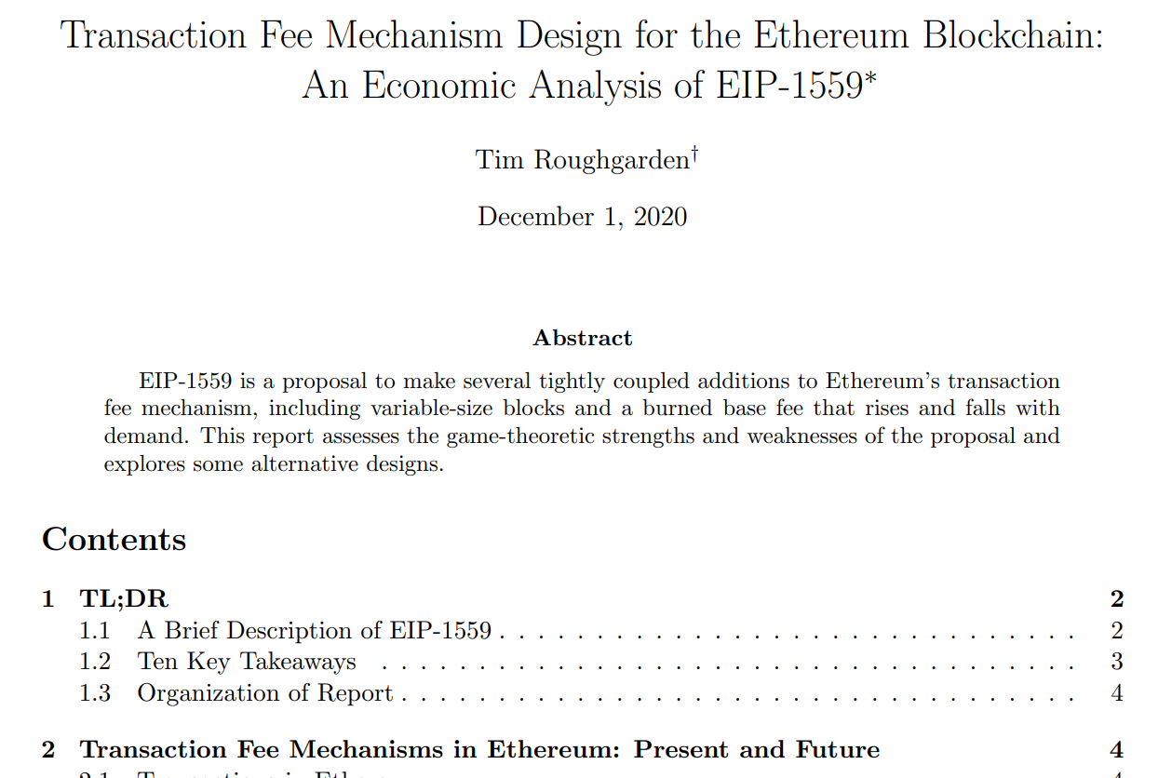
This works
Paper proves that miners …
Incentivized to follow inclusion rule
Disincentivized from including fake txns
No incentive for off-chain deals

Slide 60
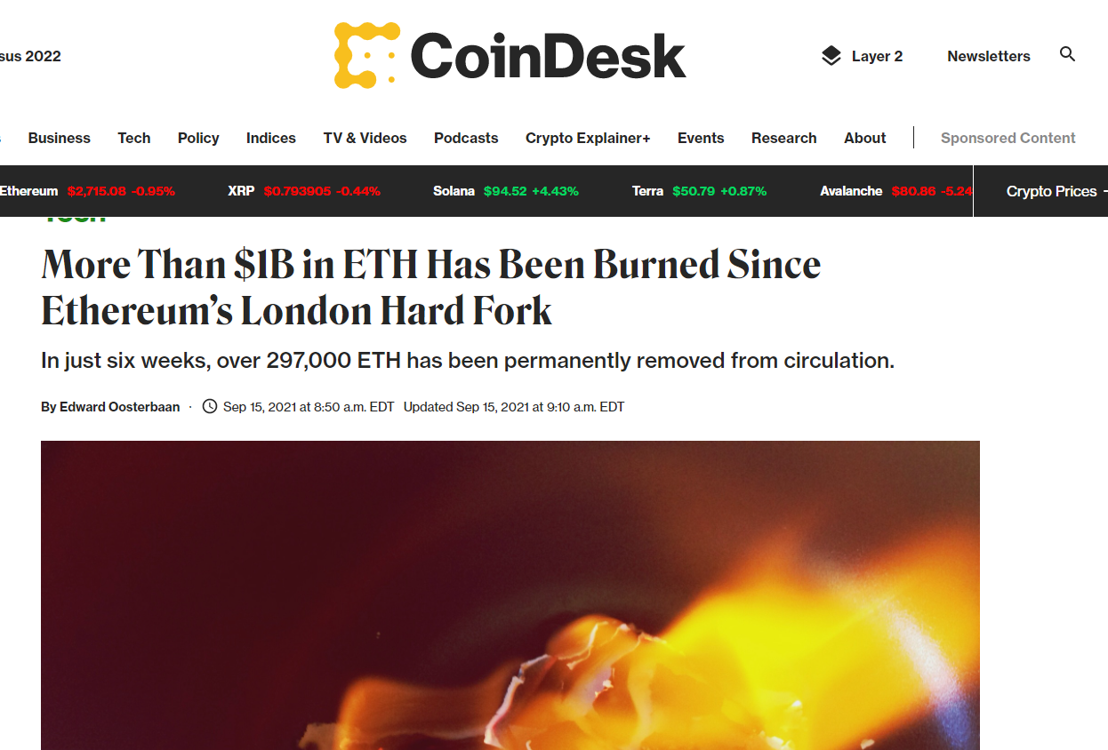
Burning ETH makes remaining ETH more valuable
Before:
Ethereum mildly inflationary
After
Hard to tell, maybe deflationary
“monetary policy” harder now

Slide 61

Ideas we covered in this lecture
Review old-school gas
Regrets in first-price auctions
Problems with uniform-price auctions
London Hard Fork
Base fee calculation
Tips!

Slide 62
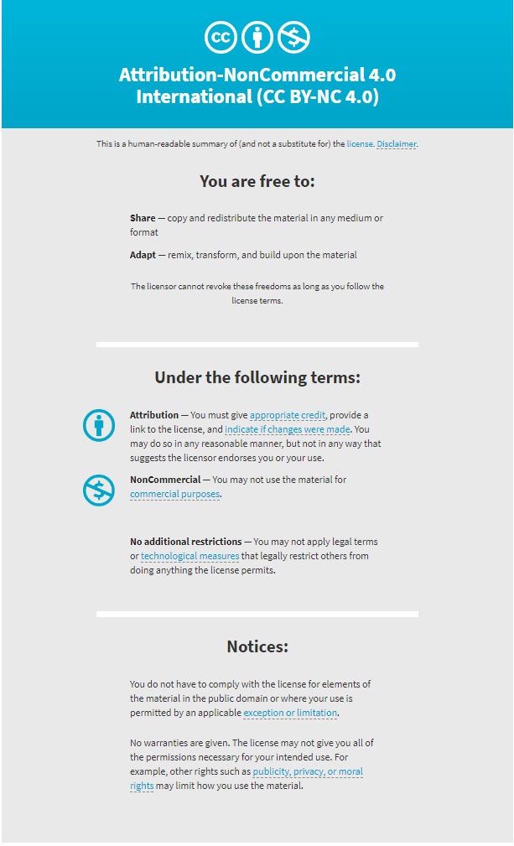

Slide 63
Title
one
two
three
four
five

